Slide 1
RFID Security Issues
Derrick Murphy
Dr. Irwin
Spring 17 - Hardware and Media Security

Slide 2
What is RFID
Radio Frequency Identification (RFID)
Is a technology for automated Identification of objects and people.
RFID may be viewed as a means of clearly labeling objects to facilitate their “perception” by computing devices.
Notes:
https://www.researchgate.net/profile/Gurudatt_Kulkarni/publication/258251156_RFID_Security_Issues/links/0deec5279d1df4ee5b000000.pdf

Slide 3
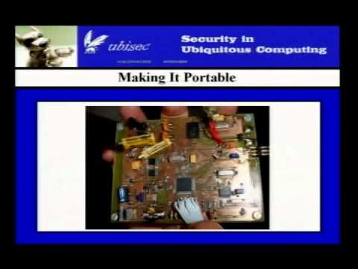
About RFID and Applications
RFID technology has been implemented many ways
Starts at 3:15 – 14:00

Slide 4
Potential
RFID is expected to completely replace the bar code systems in near future.
May provide huge savings due to increased productivity.
In many cases, the security part is simplified in order to minimize a tags price.
RFID tags may pose security and privacy risks to both organizations and individuals.

Slide 5
Advantage of RFID
RFID supporters believe it has two major advantages over bar code and other technologies.
Exclusive identification: RFID emits a exclusive serial number that differentiates among many loads of similar goods. These exclusive identifiers in RFID tags can act as indicators to data-bank entries comprising rich transaction data for individual objects.
Automation: RFID tags are detectable and readable without line of sight contact with RFID readers and without precise positioning. RFID readers can scan RFID tags at the rate of hundreds per second. For Example, RFID reader is able to scan all stacks of goods passing through the door of a Walmart warehouse with high accuracy.

Slide 6
Security and Privacy Issues
Spoofing
Jamming
Eavesdropping
Replay Attack
Deactivation
Man-in-the-middle attack
Trace-ability
Industrial Espionage
Side Channel Analysis
Skimming

Slide 7
Spoofing
Defined as duplicating tag data and transmitting it to a reader.
Data acquired from a tag, by whatever means, is transmitted to a reader to mimic a legitimate source.
A person could replace the RFID tag on an item to get a cheaper price.
If the security protocol used in the RFID channel is revealed, attackers can write blank RFID tags with the same formatted data that has been collected.

Slide 8
Jamming
Deliberate attempt to disturb the air interface between reader and tag
thereby attacking the integrity or the availability of the communication
Could be achieved by powerful transmitters at a large distance or through simple as shielding
air interface are not very robust
even simple passive measures can be very effective.
Paralyses the communication of an RFID system by generating a radio noise at the same frequency as that used by the system.

Slide 9
Spoofing and Jamming Demonstration
Starts at 17:30-26:30.

Slide 10
Eavesdropping
Occurs when an attacker intercepts data with a compliant reader
Due to tag memory capacity or cost, most RFID systems use clear text communication
eavesdropping is a simple but efficient means for the attacker to obtain information on the collected tag data
eavesdropped information could for example be used to collect privacy sensitive information about a person.

Slide 11
Replay Attack
the attacker abuses another person's identity by repeating the same authentication sequence as the one provided by an authorized person.
May be led by a clone of the legitimate tag or by re-sending the eavesdropped signal from a PC equipped with an appropriate card and antenna.
A specific countermeasure against replay attack is authentication of the tag e.g. with a challenge-response protocol.

Slide 12
Deactivation
This attack renders the transponder useless through the unauthorized application of delete commands or kill commands, or through physical destruction
Depending on the deactivation the reader can either:
no longer detect the identity of the tag.
detect the presence of the tag in the reading range.

Slide 13
Man-in-the-middle attack
When attacker interrupts the communication path and manipulate the information back and forth between RFID components.
This is a real-time threat.
The attack reveals the information before the intended device receives it and can change the information en route.
RFID system is particularly vulnerable to MITM attacks because the tags are small in size and low in price, all of which means that there is generally a lack of sophisticated protection circuitry.

Slide 14
Trace-ability
An RFID reader at a place could track RFID tagged clothes, bank notes etc. carried by individuals passing by.
Compiling data from numerous tag readers could trace the movement, social exchanges and financial transactions etc. of that person. This violates a person’s location privacy.

Slide 15
Industrial Espionage
Logistics and inventory data hold substantial monetary worth for commercial companies and their competitors. A company’s tagged goods inventory may be examined by a competitor by conducting secret scans. By compiling the changes over time, competitor would be able to get sales data, rate of inventory turnover, shopping patterns of consumers and other inventory movement routine.

Slide 16
Side channel analysis:
This analysis is based on the difference in power consumption when the RFID tag receives incorrect or correct password. Attackers analyze this change in power consumption to crack the password.

Slide 17
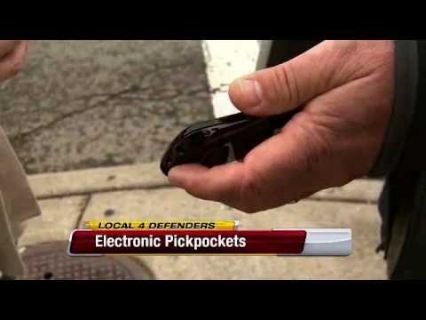
Skimming
Form of digital theft that allows smart cards with RFID technology to be duplicated.

Slide 18
Counter Measures
Non-Cryptographic counter measures:
RFID Blocking Wallet
Destroy the tag measure
Re-writable Memory
Cryptographic Measures:
Hash based entry regulator
Randomized Access Control
XOR based One-Time Pad

Slide 19

RFID Blocking wallet
Wallet used to prevent RFID signal from being detected.
Start 4:55-6:36

Slide 20
Destroy the tag measure
In order to protect consumer privacy, the best measure is to destroy the RFID tag before they goods are placed in the hands of customers.
This can be done by detaching the antenna or short circuiting the tag coil.
A tag with Auto-ID feature destroys itself upon getting a unique 8-bit password from the reader.

Slide 21
Re-writable Memory
In this type of RFID tags, each tag is equipped with ROM and a re-writable RAM.
A unique and permanent ID is set for the tag in the ROM by the manufacturer.
In RAM, a temporary code is set by the holder of the RFID tag, The
ROM mode offers unrestricted identification of items for any number of users
RAM mode, the constraint of item identity to limited user is attained.

Slide 22
Hash based entry regulator:
This concept involves locking and unlocking the transponder to permit access. For this measure to function, the tag should invoke the hash function and manage keys at the back-end. The tag only reveals its stored information when the reader sends the correct key matching to the meta-ID.

Slide 23
Randomized Access Control:
Randomized access control is a measure to improve trace-ability.
Tags, besides having the hash feature, they also have a random digit generator. The tags works in a locked or unlocked state. An unlocked tag can be easily locked using simple instruction from the RFID reader. A tag answers to the RFID readers request by producing a random number, r and then interpret its ID connected with r and sending both the data to the RFID reader. A genuine RFID reader recognizes one of its tags by carrying out a search of its own IDs, interpreting each of them with the connected r until it finds the match.
This method is practical for owners of comparatively lesser number of tags.

Slide 24
XOR based One-Time Pad:
This technique only needs an XOR evaluation and therefore can be implemented at a very low cost.
In this method, the RFID reader and the RFID tag shares the same list of random keys and they confirm that both has the same list in few exchanges.
When the evaluation passes, the tag sends its ID. This technique involves several exchanges between the RFID reader and tag.

Slide 25
Citation
https://www.researchgate.net/profile/Gurudatt_Kulkarni/publication/258251156_RFID_Security_Issues/links/0deec5279d1df4ee5b000000.pdf
"Account Navigation RFID: Security Issues Faced and Counter Measures." LinkedIn. N.p., 6 May 2016. Web. 29 Mar. 2017. <https://www.linkedin.com/pulse/rfid-security-issues-faced-counter-measures-fahman-abdul-latheef>.
https://www.youtube.com/watch?v=AWwVokZfEls
https://www.youtube.com/watch?v=x3S_6EJCjn0
https://www.youtube.com/watch?v=6f41ydcaAzo

Slide 26
Quiz
What is Side Channel Analysis?
Name 3 RFID security counter measures.

